Slide 1
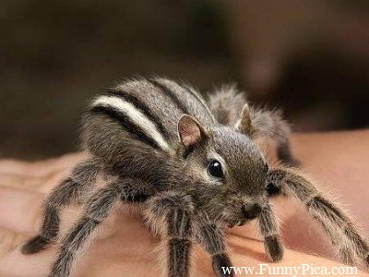
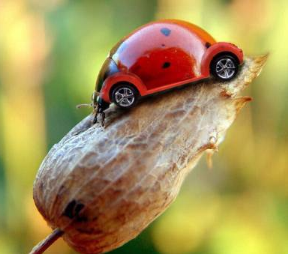
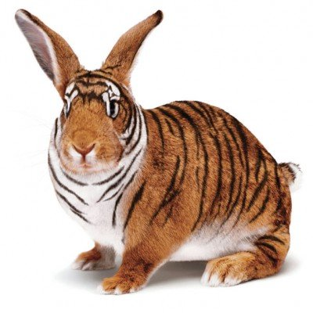
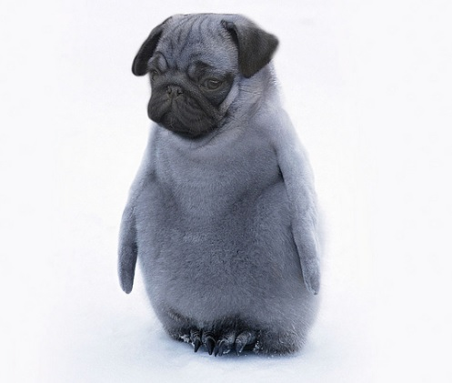
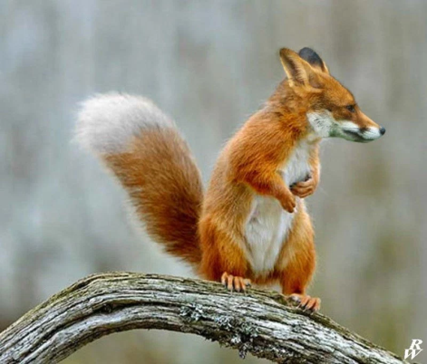
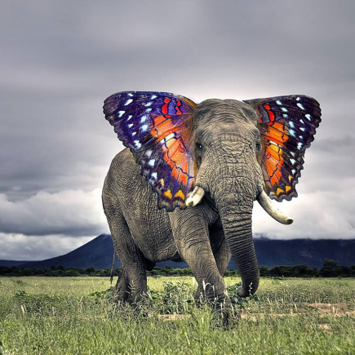
Real or Fake?
These days, you can’t get on social media or the internet without seeing digitally altered, manipulated images or Artificial Intelligence images.
While some of these manipulations are (arguably!) harmless “PhotoShopping” to create cute hybrid animals, there are more sinister repercussions to other, less obvious manipulations.
What might be some other reasons for image manipulation?
Notes:
To affect the way you feel about a person, to impact your views on an issue, to cause fear/panic, to engender a lack of trust, to emphasise the importance of someone or something, to make money, to coerce or blackmail, to make an issue or person look silly or unimportant

Slide 2
Real or Fake?
Now that you’ve considered some of the reasons people may choose to manipulate an image, it’s time to think about the ways that people actually do it. Is it Adobe, Canva and other programs?
How else might someone manipulate the way someone sees an image?
Notes:
Cropping, adding text, comparing and contrasting with other photos, misdating/titling the image, deliberate placement of images with unrelated but close by text, choosing specific angles or moments which make the subject of the image look a certain way.

Slide 3
Real or Fake?
So, even totally “real” pictures can be used to serve someone’s interests by cropping the pictures in certain ways, adding different captions/supporting text, or saying the picture was taken at certain times or places which it may not have been.
On the next page, there is an image. Your task is to write three captions for this image, each with a different goal in mind.
Purpose 1: To garner support for this person
Purpose 2: To make this person look silly
Purpose 3: Your choice- identify a purpose and then meet it!

Slide 4
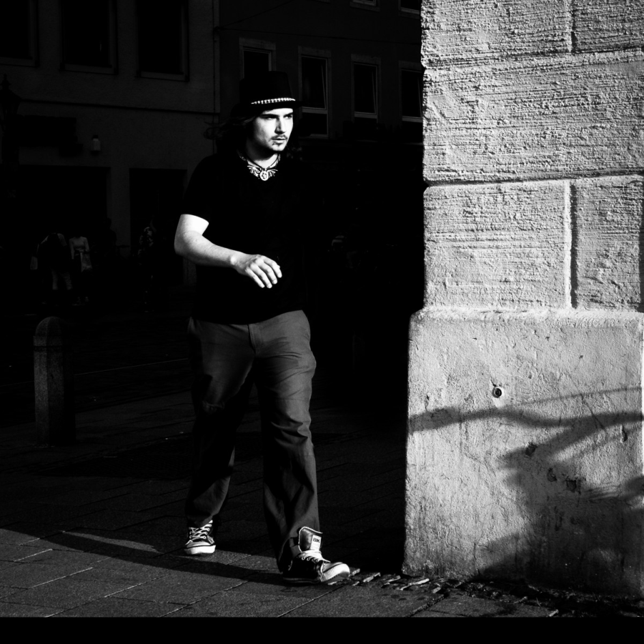
Real or Fake?
Purpose 1:
Purpose 2:
Purpose 3:

Slide 5
Real or Fake?
As consumers, how do we know what’s true?
Brainstorm ways of finding out the TRUTH behind different images.
How could you check if an image (and the text associated) is telling the whole story?
Write your ideas below.
Notes:
Reverse google image search, look at other images of the same event, check shadows, find the original photo and compare it to the version you have, check “debunking” or “fact checking” sites like snopes.com, look at metadata associate with it (see http://www.abc.net.au/news/science/2018-02-11/fake-news-hoax-images-digitally-altered-photos-photoshop/9405776 for how to)

Slide 6
Real or Fake?
In groups (or by yourself), look at a news site find three images.
When you find these images, annotate them with:
The purpose of the image
The way the image is presented to persuade
If you believe the image has been manipulated
If so, how has it been manipulated?
The ultimate effect of the image

Slide 7
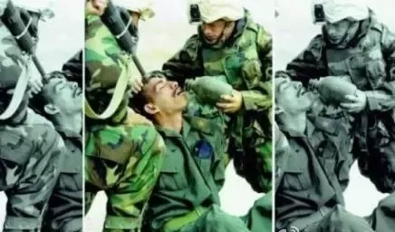
Real or Fake?
In the image below, the use of cropping is obvious. What might the purpose of each of the versions of this image be?
A.
B.
C.

Slide 8
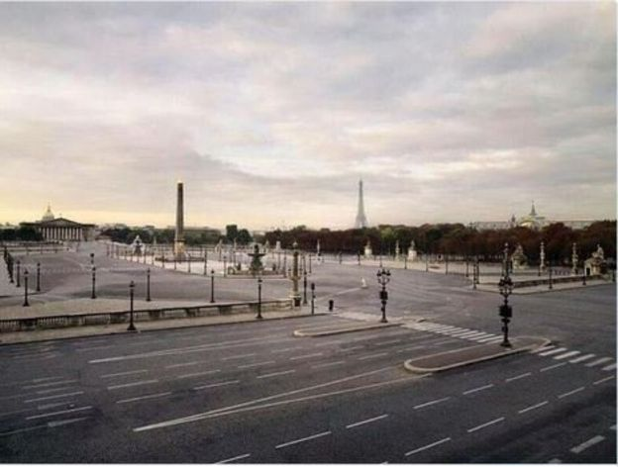
Real or Fake?
This image was widely shared after the shootings in Paris in 2015. It was said to depict the empty Paris streets after the deadly shootings. Is this picture real? How could you find out?
A.
B.
C.

Slide 9
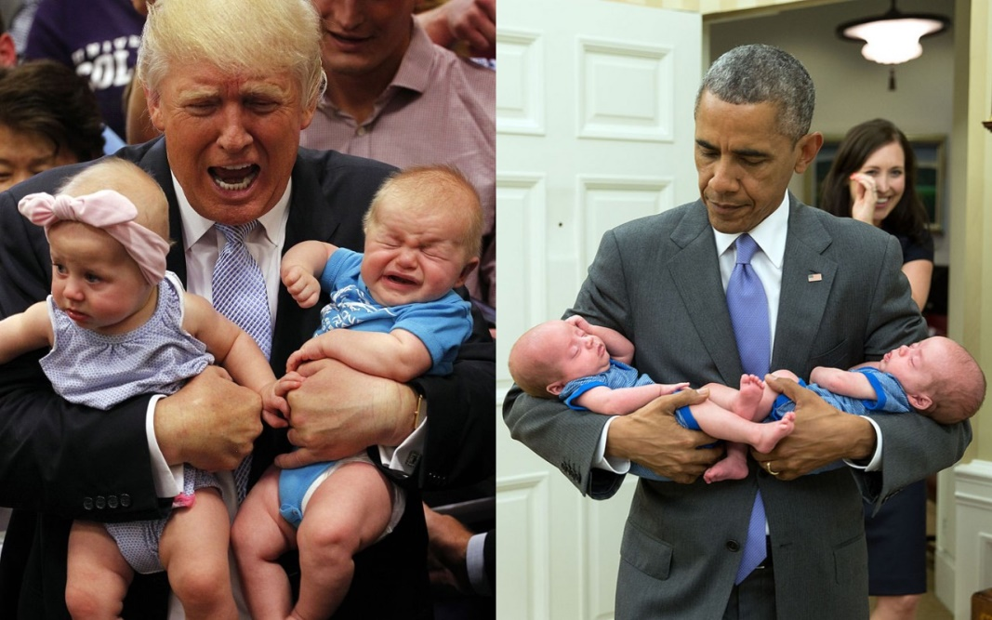
Real or Fake?
These two images were placed next to each other for a specific reason.
What do you think the purpose of this choice was?
Find another two pictures of the same two people which could be placed next to each other to have the opposite effect on the audience

Slide 10
Real or Fake?
Photography activity:
In your groups, decide on:
A subject/issue
A purpose
A method
And take/edit an image which meets your purpose, using the method you have nominated. This could be photo editing, proximity, cropping, addition of text… anything!
Show the original and the edited version to another group and have them answer:
What the purpose of the edits were and where the edits were made.
Have fun!

